Slide 1


Slide 2
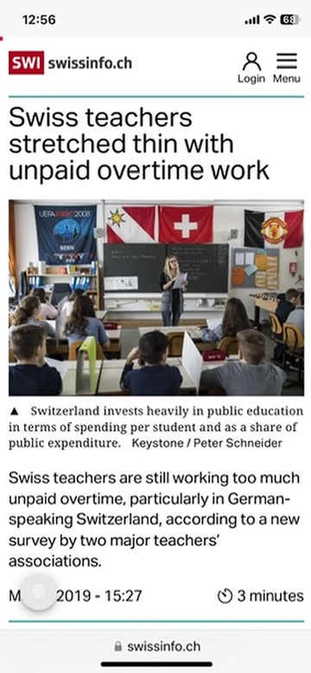



Teachers Overworked
Notes:
What is the problem? News articles

Slide 3


Teachers Overworked
Notes:
What is the problem? News articles

Slide 4
How People Learn?
Prior knowledge + New information = New knowledge
Notes:
Importance of the industry: Growth averaging just under 6%
Industry supports $2.7 trillion (3.6%) of the world's gross domestic product (GDP)
Historically, air transport has doubled in size every 15 years and has grown faster than most other industries
We live on a relatively small island which has a high dependence on international trade for our economic well-being
Leasing dependant on the growth of the industry

Slide 5
How People Learn?
Prior knowledge + New information = New knowledge
Notes:
Importance of the industry: Growth averaging just under 6%
Industry supports $2.7 trillion (3.6%) of the world's gross domestic product (GDP)
Historically, air transport has doubled in size every 15 years and has grown faster than most other industries
We live on a relatively small island which has a high dependence on international trade for our economic well-being
Leasing dependant on the growth of the industry

Slide 6
How People Learn?
Prior knowledge + New information = New knowledge
Confused
Notes:
Importance of the industry: Growth averaging just under 6%
Industry supports $2.7 trillion (3.6%) of the world's gross domestic product (GDP)
Historically, air transport has doubled in size every 15 years and has grown faster than most other industries
We live on a relatively small island which has a high dependence on international trade for our economic well-being
Leasing dependant on the growth of the industry

Slide 7
What if teachers could efficiently track individual student progress and identify knowledge gaps?
Notes:
Importance of the industry: Growth averaging just under 6%
Industry supports $2.7 trillion (3.6%) of the world's gross domestic product (GDP)
Historically, air transport has doubled in size every 15 years and has grown faster than most other industries
We live on a relatively small island which has a high dependence on international trade for our economic well-being
Leasing dependant on the growth of the industry

Slide 8
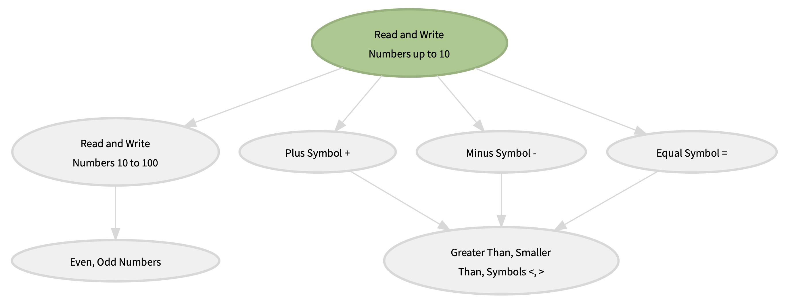
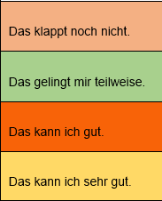
What if teachers could efficiently track individual student progress and identify knowledge gaps?

Slide 9
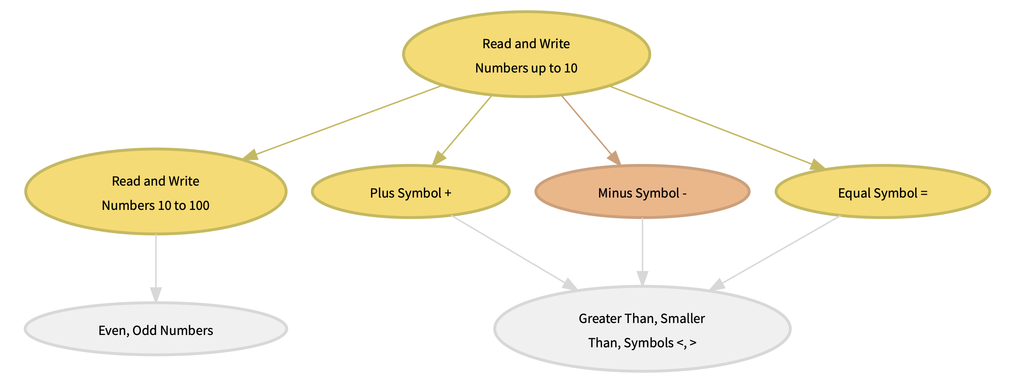
What if teachers could efficiently track individual student progress and identify knowledge gaps?

Slide 10
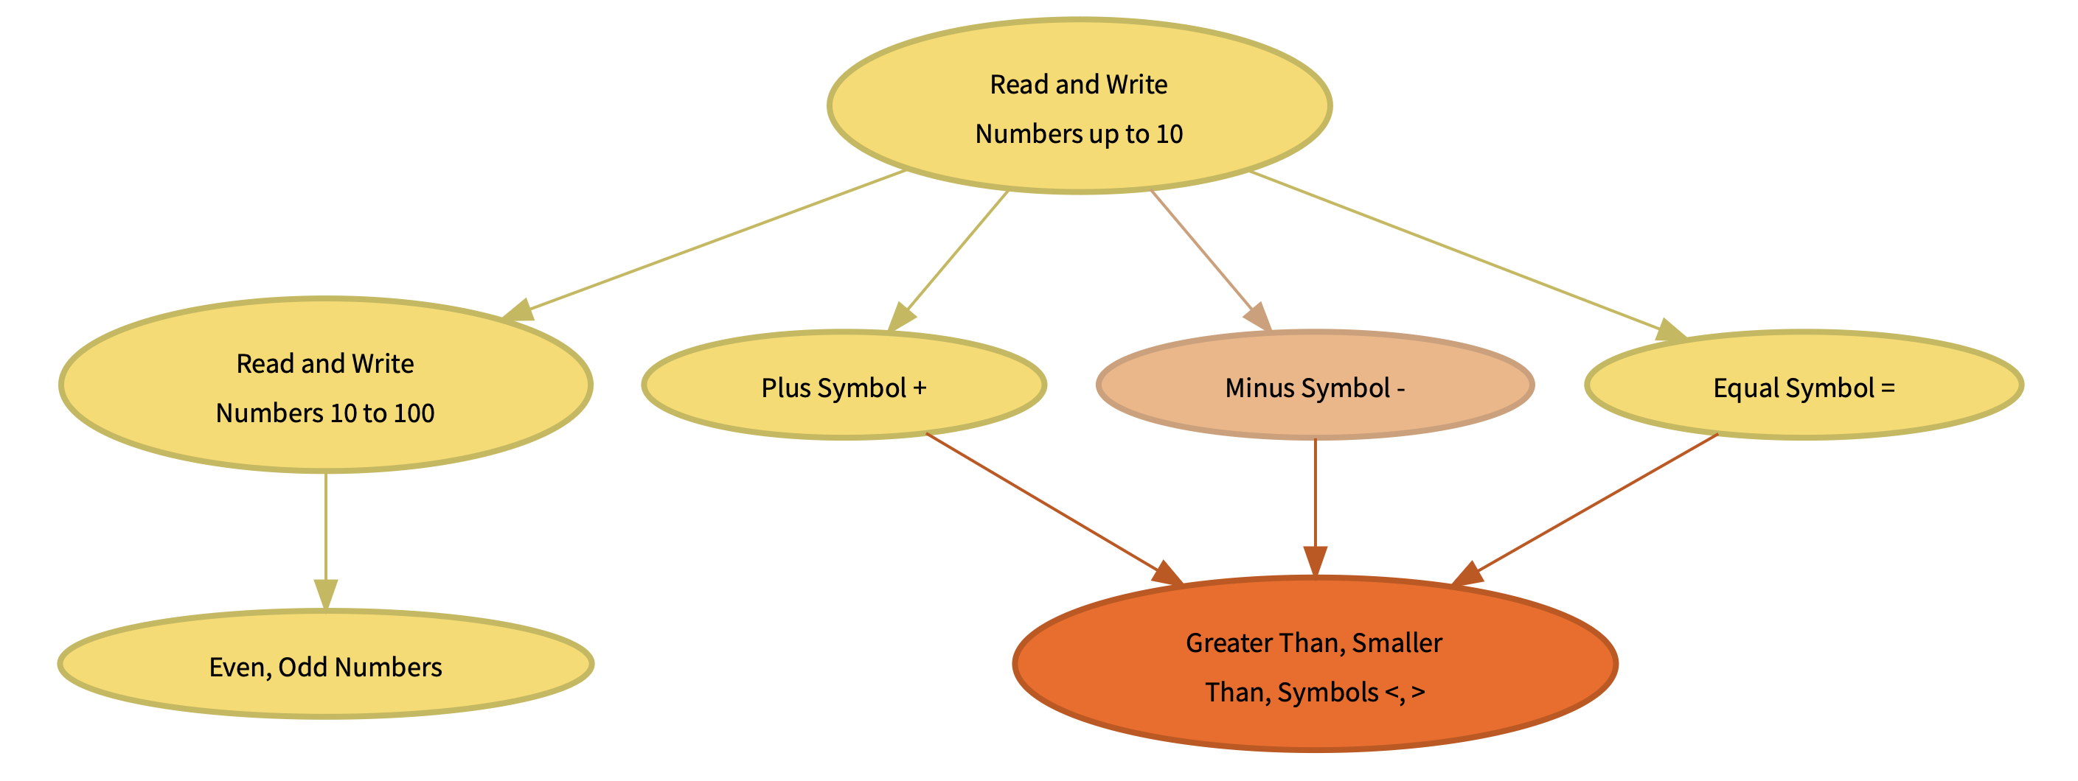
What if teachers could efficiently track individual student progress and identify knowledge gaps?
Weak Point

Slide 11
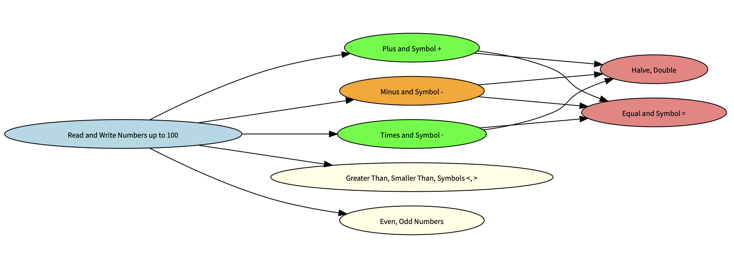
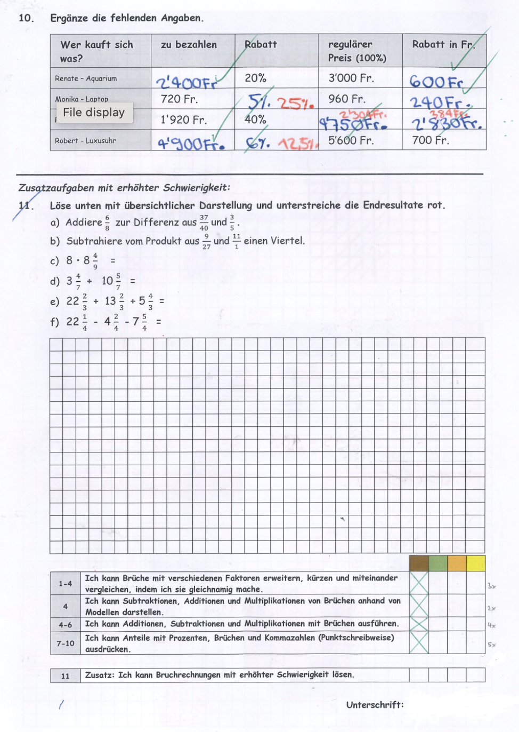
What if teachers could efficiently track individual student progress and identify knowledge gaps?
Notes:
How?

Slide 12
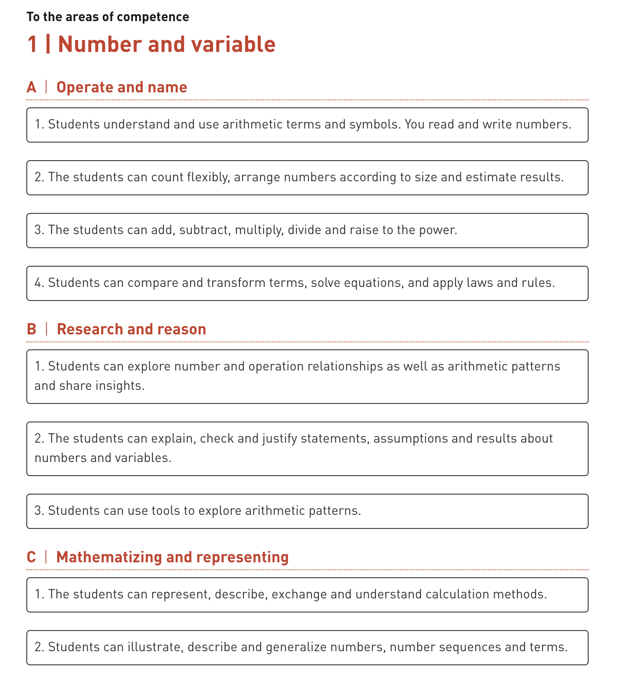
What if teachers could efficiently track individual student progress and identify knowledge gaps?
Curriculum Map
Student Results
+
Notes:
How?

Slide 13

What if teachers could efficiently track individual student progress and identify knowledge gaps?
LLM
Notes:
How?

Slide 14
What if teachers could efficiently track individual student progress and identify knowledge gaps?
Personalised
Recommendations
LLM
Notes:
How?

Slide 15
Benefits
Teacher
Parent/Guardian
Student

Slide 16
Thank You

Slide 17
Thank You
Notes:
To conclude, there is no apparent quick fix to problem of emissions. This solution is an intermediate one, which allows the industry to grow while also preparing it for the future.

Slide 18
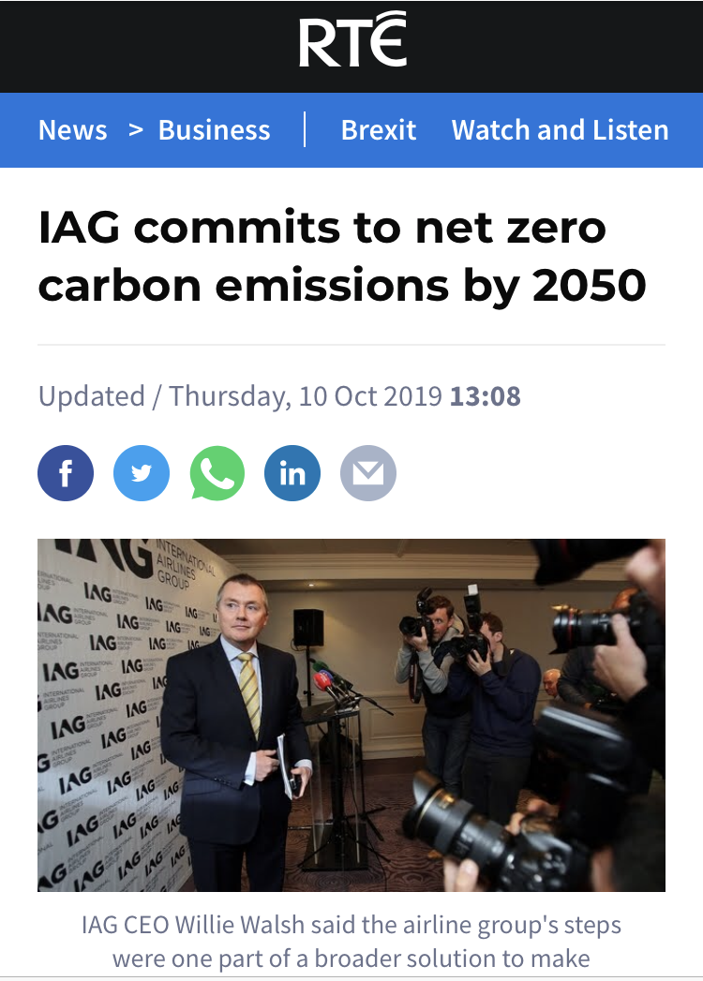



Engagement
CSR Initiative
Subsidised Electricity
Infrastructure for the Future
Tool for Reducing Emissions
Reduced effect of ‘flight shaming’
Growth of Industry
Improved Image
Reduced Net Carbon Emissions
Industry
Consumer
Airlines
Environment
Marketing Campaign
Business Marketing Tools
CSR
Subsidised Electricity
Infrastructure for the Future
Notes:
Tool for Reducing Emissions
Build trust using a brand

Slide 19
Business Plan
Develop Platform
Trial and user feedback
Create marketing campaign
Pitch to different cantons
Reinvest and expand

